Slide 1
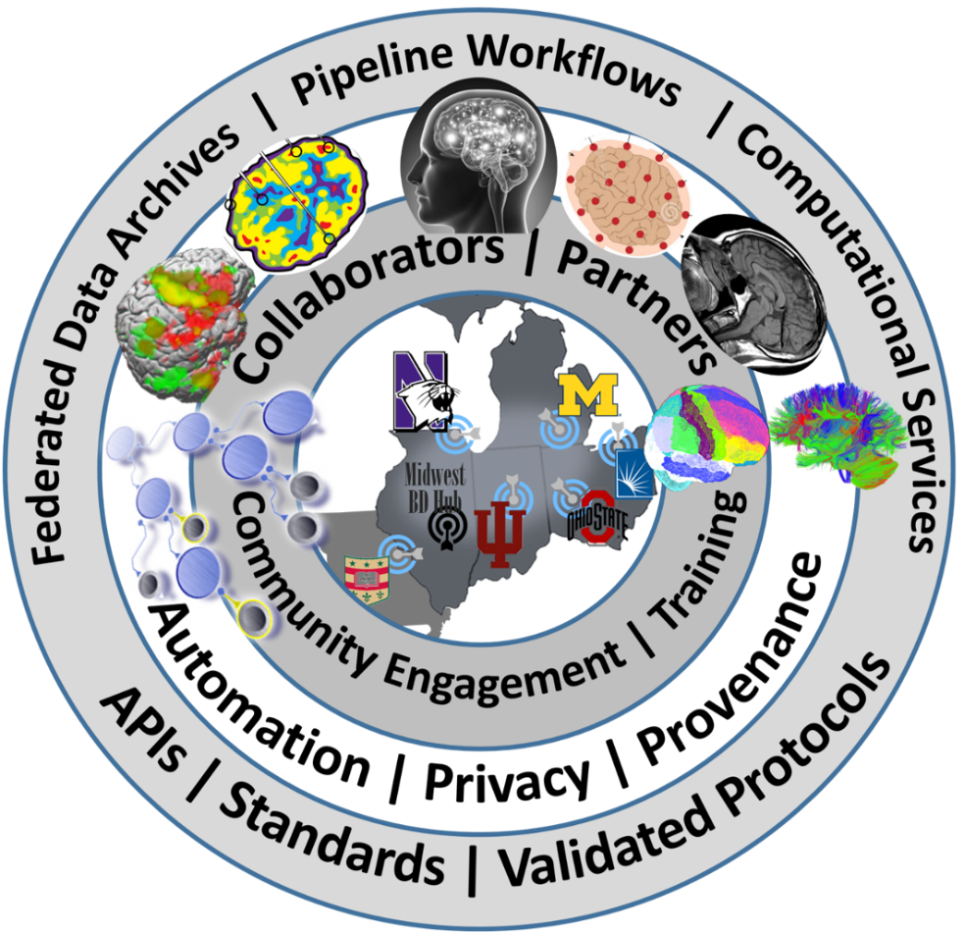

Midwest Workshop on Big Neuroscience Data, Tools, Protocols & Services
Computational Neuroscience Network (ACNN)
http://www.NeuroscienceNetwork.org/ACNN_Workshop_2016.html

Slide 2


Predictive Big Data Analytics
Ivo D Dinov
Statistics Online Computational Resource (SOCR)
Michigan Institute for Data Science (MIDAS)
University of Michigan
http://www.umich.edu/~dinov

Slide 3
Characteristics of Big Biomed Data
IBM Big Data 4V’s: Volume, Variety, Velocity & Veracity
BD Dimensions | Tools
Size | Harvesting and management of vast amounts of data
Complexity | Wranglers for dealing with heterogeneous data
Incongruency | Tools for data harmonization and aggregation
Multi-source | Transfer and joint modeling of disparate elements
Multi-scale | Macro to meso to micro scale observations
Incomplete | Reliable management of missing data
Example: analyzing observational data of 1,000’s Parkinson’s disease patients based on 10,000’s signature biomarkers derived from multi-source imaging, genetics, clinical, physiologic, phenomics and demographic data elements.
Software developments, student training, service platforms and methodological advances associated with the Big Data Discovery Science all present existing opportunities for learners, educators, researchers, practitioners and policy makers
Dinov, et al. (2014)
Notes:
What is Big Data? Big data is very different from traditional (small) data due to the exotic challenges it presents and because of its potential to revolutionize our understanding of the world around us. There are 6 characteristics that make Big Data unique. These 6-dimensions (6Ds) of Big Data are defined by its unique attributes: (1) Size – the volume of data exceeds standard storage, memory and computational capabilities, (2) Incongruency – samples, cases and observations in the data may be highly non-homologous, which requires special treatment during the data analytics phase, (3) Incompleteness – Big Data may be sparse with (random and non-random causes of) missing values due to the en masse nature of generation and collection of data elements, (4) Complexity – as the dimension of the data increases distance metrics between observations become degenerate (curse of dimensionality) leading to considerable computational and interpretation challenges, (5) Multi-scale – Big Data frequently includes observations from micro to meso to macro levels, across time, space and frequency spectra, and (6) Multi-source – numerous digital, analogous and mixed data is produced by devices and instruments demand integration (fusion) of relevant data within and beyond the scope of any specific research study. These 6Ds allow us to begin the processes of model, algorithm and tool development necessary to cope with the specific challenges that make “standard scientific methods” impractical for Big Data. Big Data science is team-based and highly trans-disciplinary. It requires diverse, broad, and complementary expertise, specialized training, continuous development efforts, high-throughput analytics, and powerful techniques for data interrogation. The scope of Big Data challenges are illustrated by the problem of analyzing observational data of 1,000’s Parkinson’s disease patients based on 10,000’s signature biomarkers derived from multi-source imaging, genetics, clinical, physiologic, phenomics and demographic data elements. Similar data-driven exploratory and confirmatory analytic examples can be demonstrated in other disciplines. Software developments, student training, service platforms and methodological advances associated with the Big Data Discovery Science all present existing opportunities for learners, educators, researchers, practitioners and policy makers
http://www.onlinecharttool.com/graph?selected_graph=radar

Slide 4

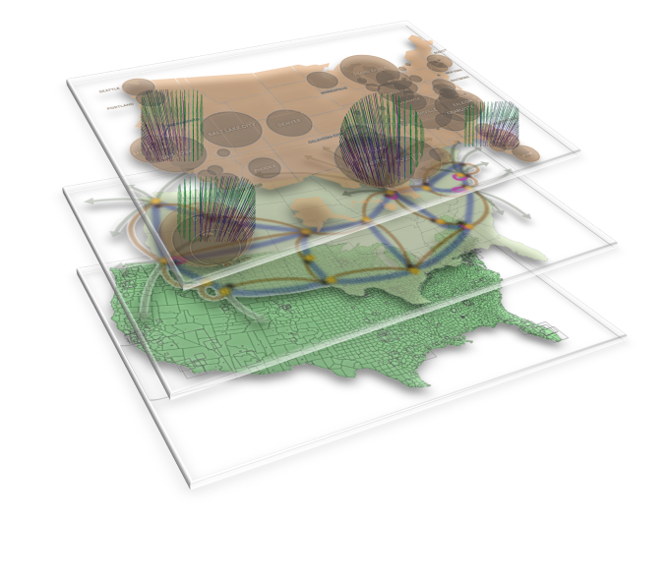
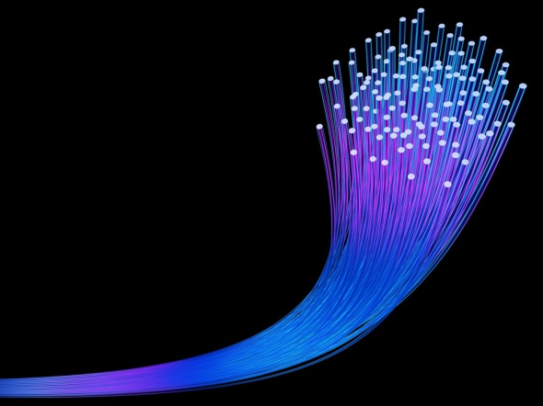
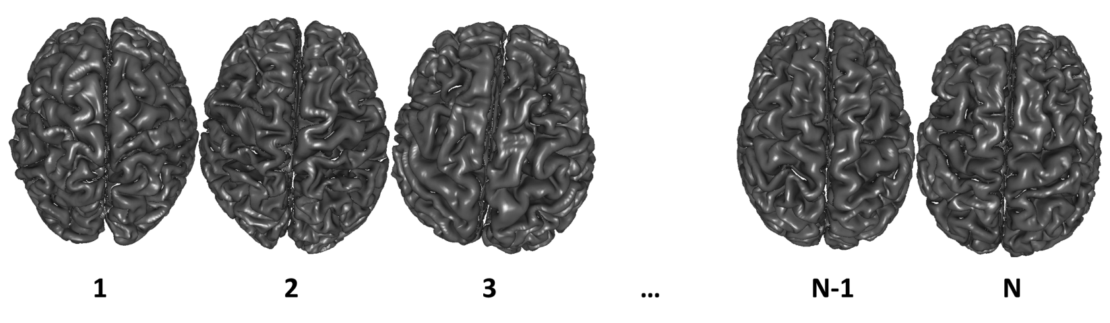
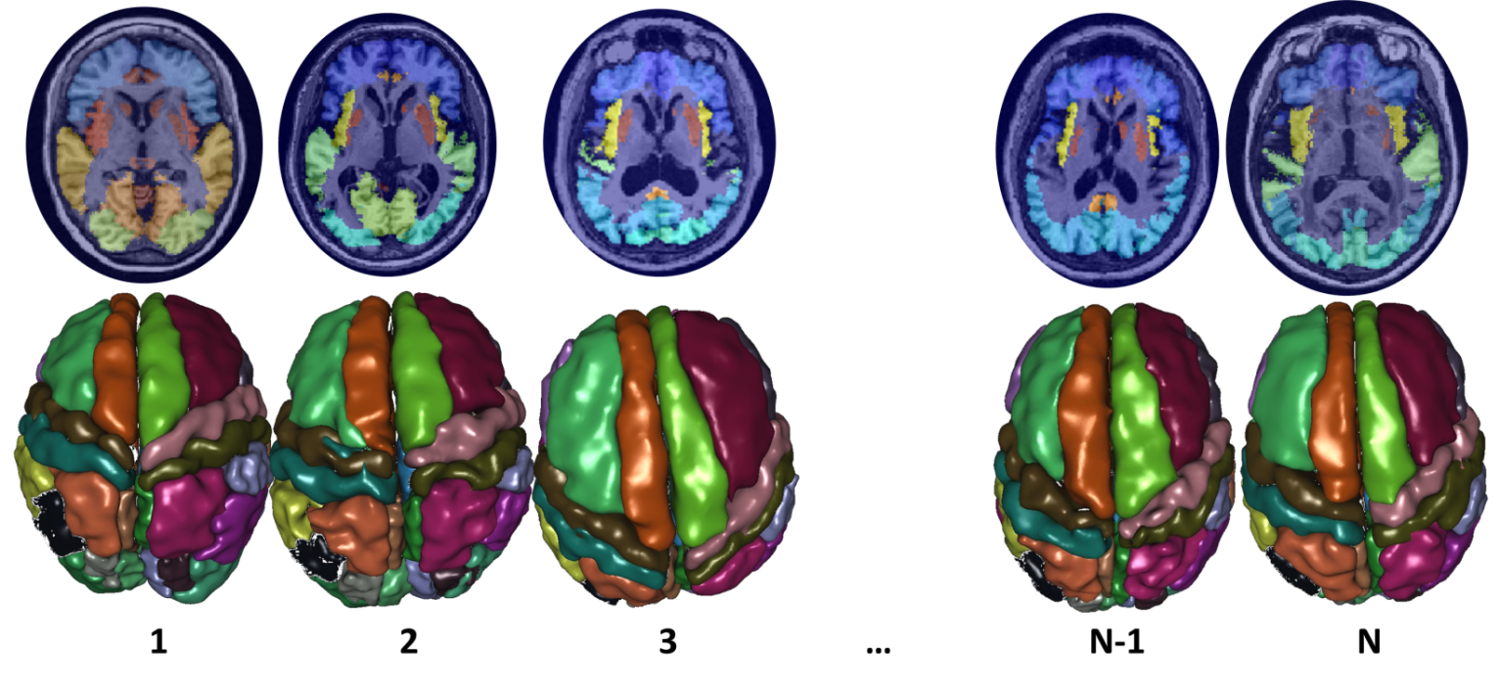
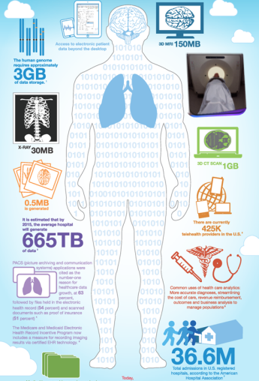



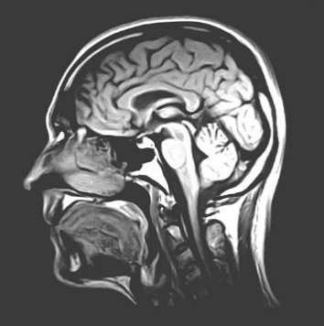

BD
I
K
A
Big Data | Information | Knowledge | Action
Raw Observations | Processed Data | Maps, Models | Actionable Decisions
Data Aggregation | Data Fusion | Causal Inference | Treatment Regimens
Data Scrubbing | Summary Stats | Networks, Analytics | Forecasts, Predictions
Semantic-Mapping | Derived Biomarkers | Linkages, Associations | Healthcare Outcomes
Dinov, GigaScience, 2016
Notes:
Neurodegenerative diseases provide an excellent example of a driving Big Data Analytic biomedical Challenge

Slide 5

End-to-end Pipeline Workflow Solutions
Dinov, et al., 2014, Front. Neuroinform.; Dinov, et al., Brain Imaging & Behavior, 2013
Notes:
Big Data has intrinsically multi-dimensional characteristics …

Slide 6
Predictive Big Data Analytics in Parkinson’s Disease
A unique archive of Big Data: Parkinson’s Progression Markers Initiative (PPMI). Defining data characteristics – large size, incongruency, incompleteness, complexity, multiplicity of scales, and heterogeneity of information-generating sources (imaging, genetics, clinical, demographic)
Approach
introduce methods for rebalancing imbalanced cohorts,
utilize a wide spectrum of classification methods to generate phenotypic predictions,
reproducible machine-learning based classification
Results of machine-learning based classification show significant power to predict Parkinson’s disease in the PPMI subjects (consistent accuracy, sensitivity, and specificity exceeding 96%, confirmed using internal statistical 5-fold cross-validation). Clinical (e.g., Unified Parkinson's Disease Rating Scale (UPDRS) scores), demographic (e.g., age), genetics (e.g., rs34637584, chr12), and derived neuroimaging biomarker (e.g., cerebellum shape index) data all contributed to the predictive analytics and diagnostic forecasting.
Model-free Big Data machine learning-based classification methods (e.g., adaptive boosting, support vector machines) outperform model-based techniques (GEE, GLM, MEM) in terms of predictive precision and reliability (e.g., forecasting patient diagnosis). UPDRS scores play a critical role in predicting diagnosis, which is expected based on the clinical definition of Parkinson’s disease. Even without longitudinal UPDRS data, however, the accuracy of model-free machine learning based classification is over 80%. The methods, software and protocols developed here are openly shared and can be employed to study other neurodegenerative disorders (e.g., Alzheimer’s, Huntington’s).
Dinov, et al., PLoS, 2016
Notes:
Imputation: In our experiments, we used the R-packages MICE (MI via chained equations) and MI to perform $m=5$ chained imputations.
Imbalanced Sample-Sizes: The R package SMOTE (Synthetic Minority Over-sampling TEchnique) facilitated the group rebalancing of the native imbalanced cohorts by creating synthetic instances of the under sampled class (e.g., controls).
Stratification: Most of our cohort comparisons were done on stratified data – by cohort-definition (HC vs PDs, or HC vs. Patients (PDs + SWEDDs)) and by cohort-size (raw unbalanced comparisons, or comparisons of SMOTE-rebalanced group sizes).

Slide 7
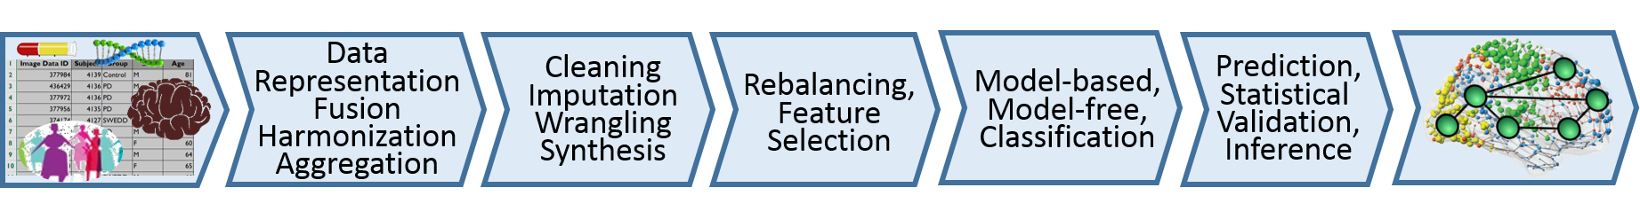
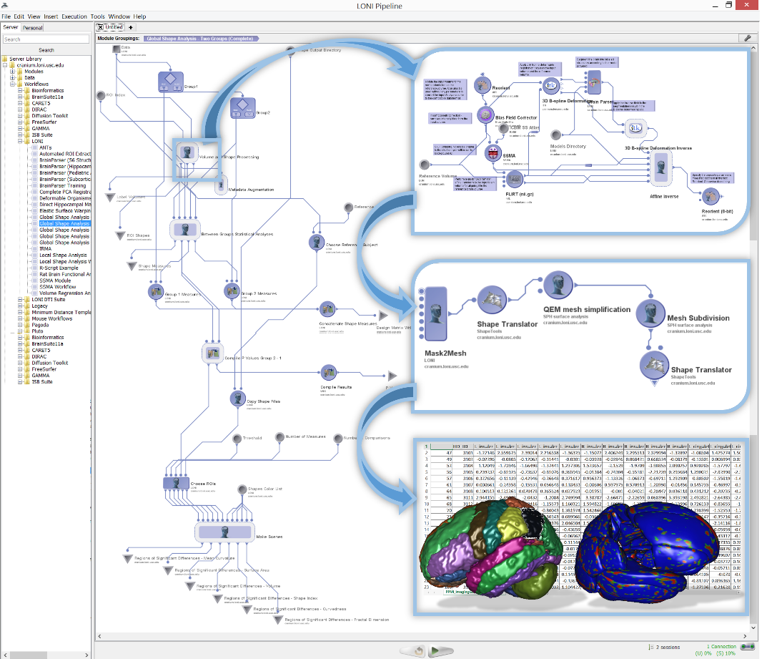
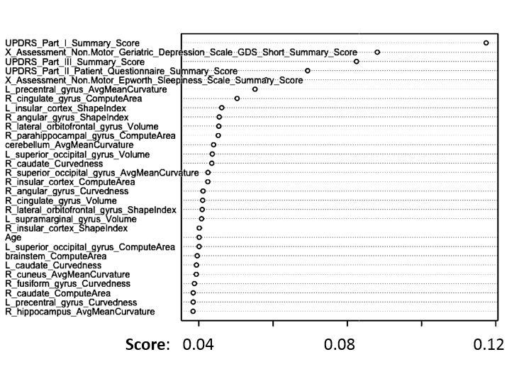
Predictive Big Data Analytics: Applications to Parkinson’s Disease
Varplot illustrating:
the critical predictive data elements (Y-axis)
and their impact scores (X-axis)
AdaBoost classifier for Controls vs. Patients prediction
ML classifier | accuracy | sensitivity | specificity | positive predictive value | negative predictive value | log odds ratio (LOR)
AdaBoost | 0.996324 | 0.994141 | 0.998264 | 0.9980392 | 0.9948097 | 11.4882058
SVM | 0.985294 | 0.994140 | 0.977431 | 0.9750958 | 0.9946996 | 8.902166
Dinov, et al., PLoS, 2016

Slide 8
Predictive Big Data Analytics: Applications to Parkinson’s Disease
Best Machine Learning Based Classification Results (according to average measures of 5-fold cross-validation)
Data Strata | Classifier | FP | TP | TN | FN | Accu-racy | Sensi-tivity | Speci-ficity | positive predictive value | negative predictive value | log odds ratio (LOR)
balanced control/PD | ada | 0.2 | 102 | 115 | 0.6 | 0.99632 | 0.99414 | 0.99826 | 0.998039 | 0.9948097 | 11.4882
balanced control/PD | svm | 2.6 | 102 | 113 | 0.6 | 0.98529 | 0.99414 | 0.97743 | 0.975096 | 0.9946996 | 8.902166
balanced control/PD&SWEDD | svm | 3.4 | 101 | 112 | 1 | 0.97978 | 0.99023 | 0.97049 | 0.967557 | 0.9911348 | 8.1120092
balanced control/PD&SWEDD | ada | 1.4 | 101 | 114 | 1.8 | 0.98529 | 0.98242 | 0.98785 | 0.986275 | 0.9844291 | 8.4214
unbalanced control/PD | ada | 0.2 | 25 | 54 | 0.8 | 0.98753 | 0.96875 | 0.99634 | 0.992 | 0.9855072 | 9.039789
unbalanced control/PD&SWEDD | ada | 1.2 | 24 | 61 | 1.8 | 0.96599 | 0.92969 | 0.98083 | 0.952 | 0.971519 | 6.516987
Dinov, et al., PLoS, 2016

Slide 9
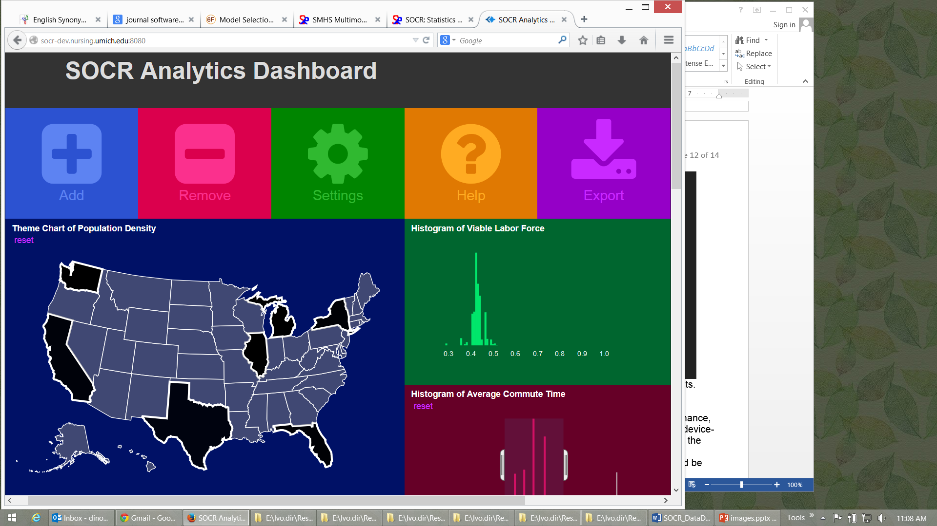
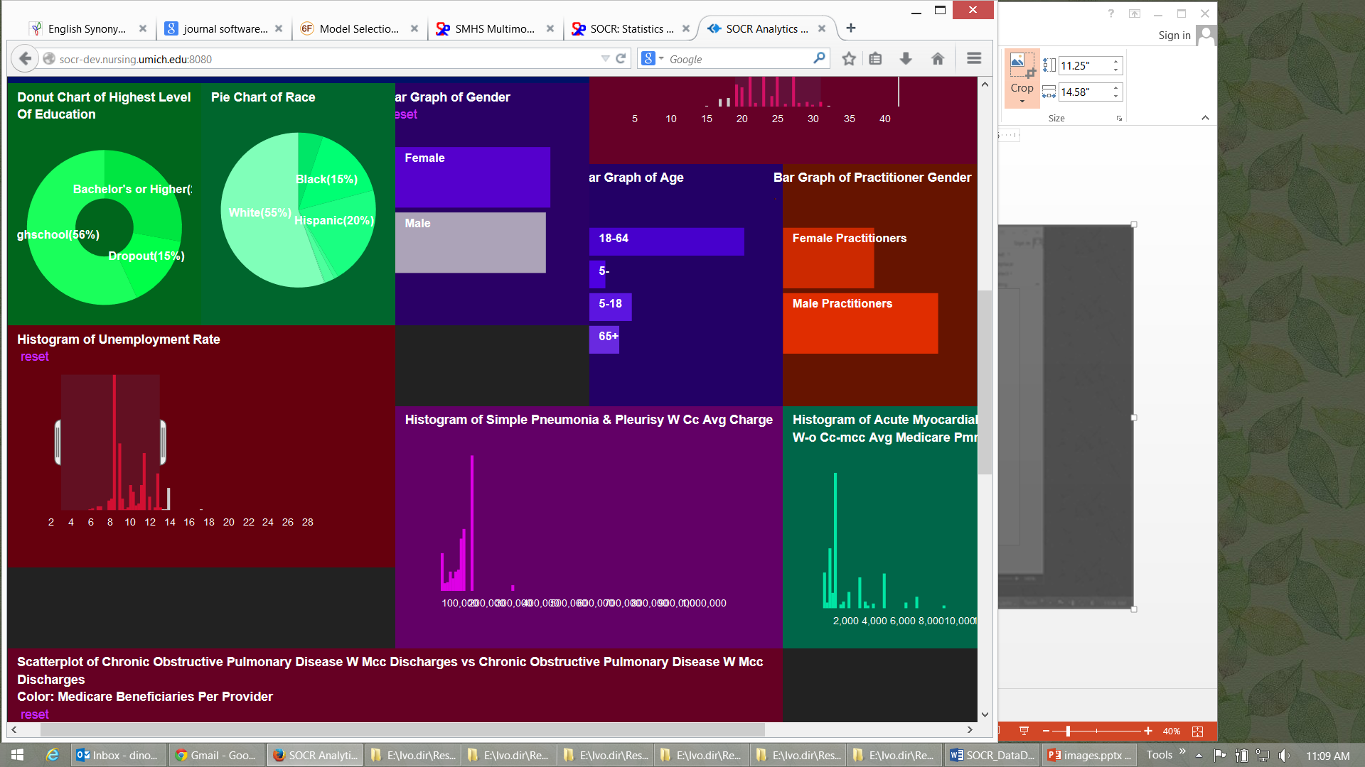
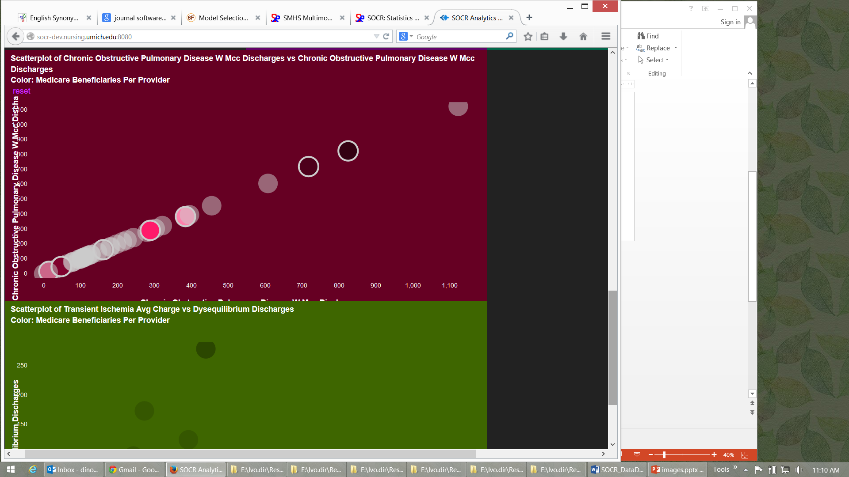
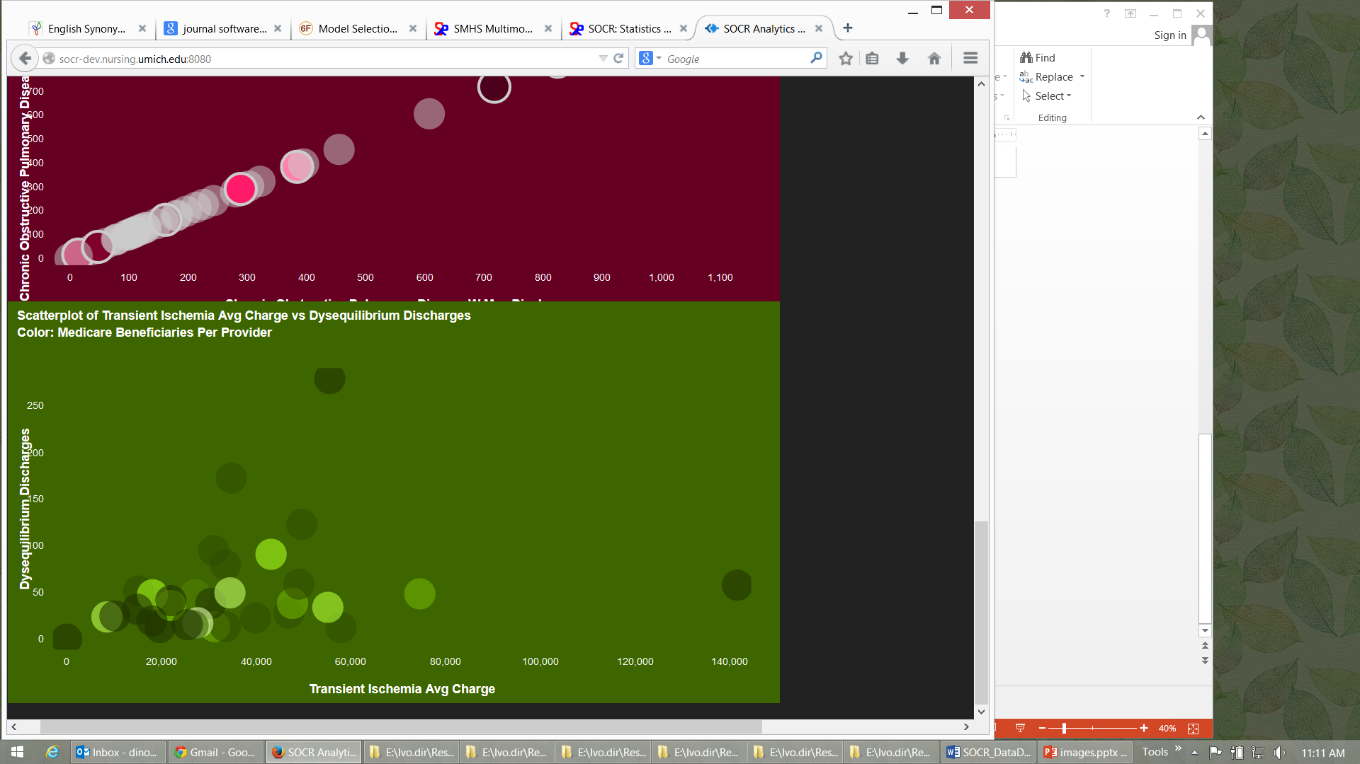
SOCR Big Data Dashboard
http://socr.umich.edu/HTML5/Dashboard
Web-service combining and integrating multi-source socioeconomic and medical datasets
Big data analytic processing
Interface for exploratory navigation, manipulation and visualization
Adding/removing of visual queries and interactive exploration of multivariate associations
Powerful HTML5 technology enabling mobile on-demand computing
Husain, et al., 2015, J Big Data

Slide 10


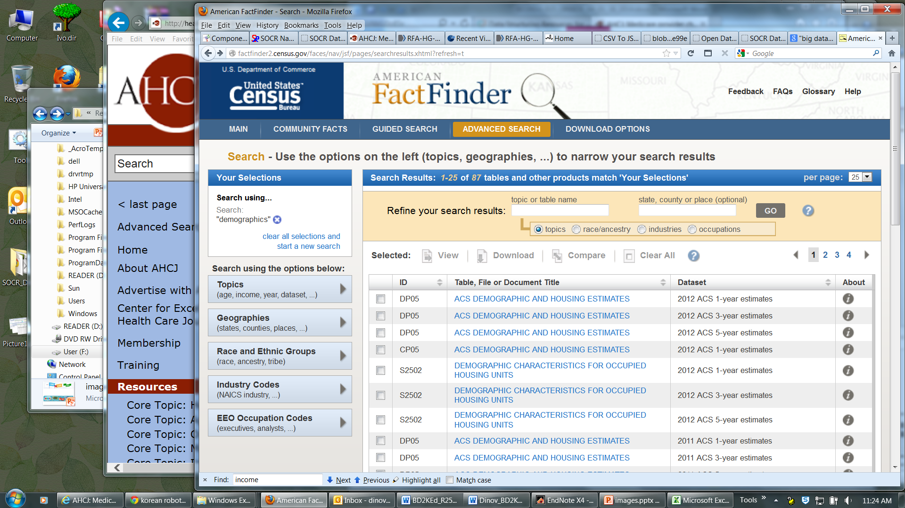
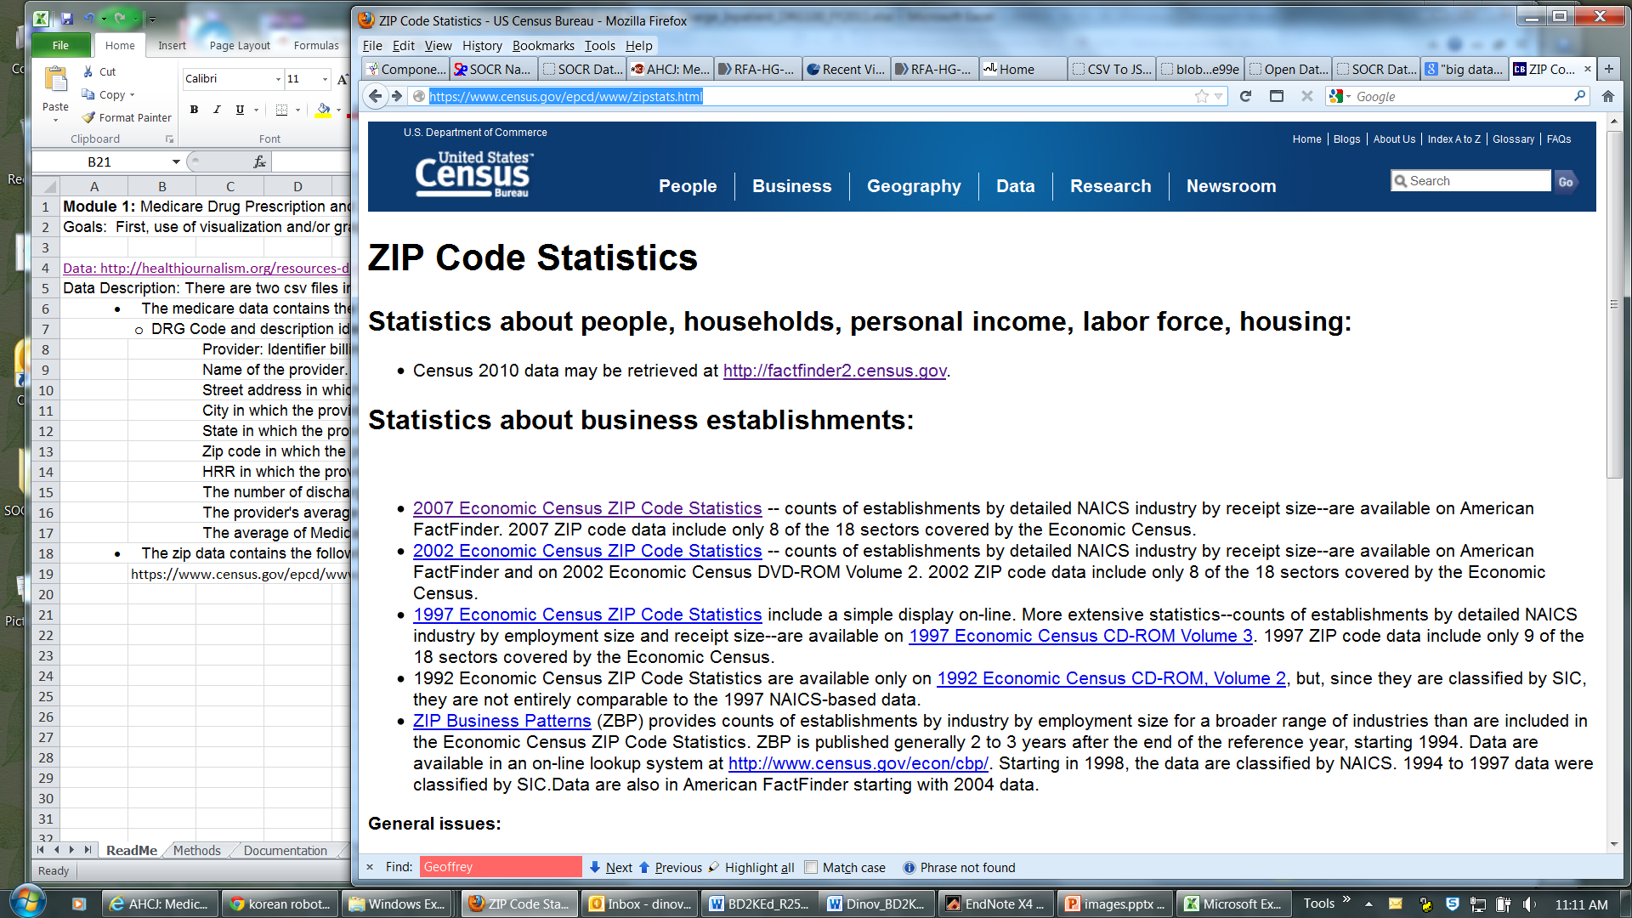
SOCR Dashboard (Exploratory Big Data Analytics): Data Fusion
http://socr.umich.edu/HTML5/Dashboard
Notes:
Imaging Pheno/Genotype Associations: Data

Slide 11
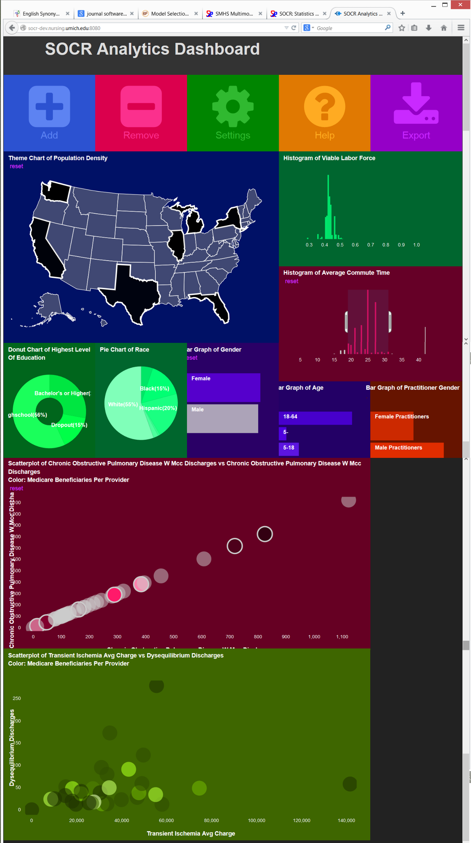
SOCR Dashboard (Exploratory Big Data Analytics): Associations
Notes:
Depression Center collaboration with Melvin McInnis and Anh Truong

Slide 12
Compressive Big Data Analytics (CBDA)
The foundation for Compressive Big Data Analytics (CBDA) involves
Iteratively generating random (sub)samples from the Big Data collection.
Then, using classical techniques to obtain model-based or non-parametric inference based on the sample.
Next, compute likelihood estimates (e.g., probability values quantifying effects, relations, sizes)
Repeat – the process continues iteratively.
Repeating the (re)sampling and inference steps many times (with or without using the results of previous iterations as priors for subsequent steps).
Dinov, J Med Stat & Info, 2016

Slide 13
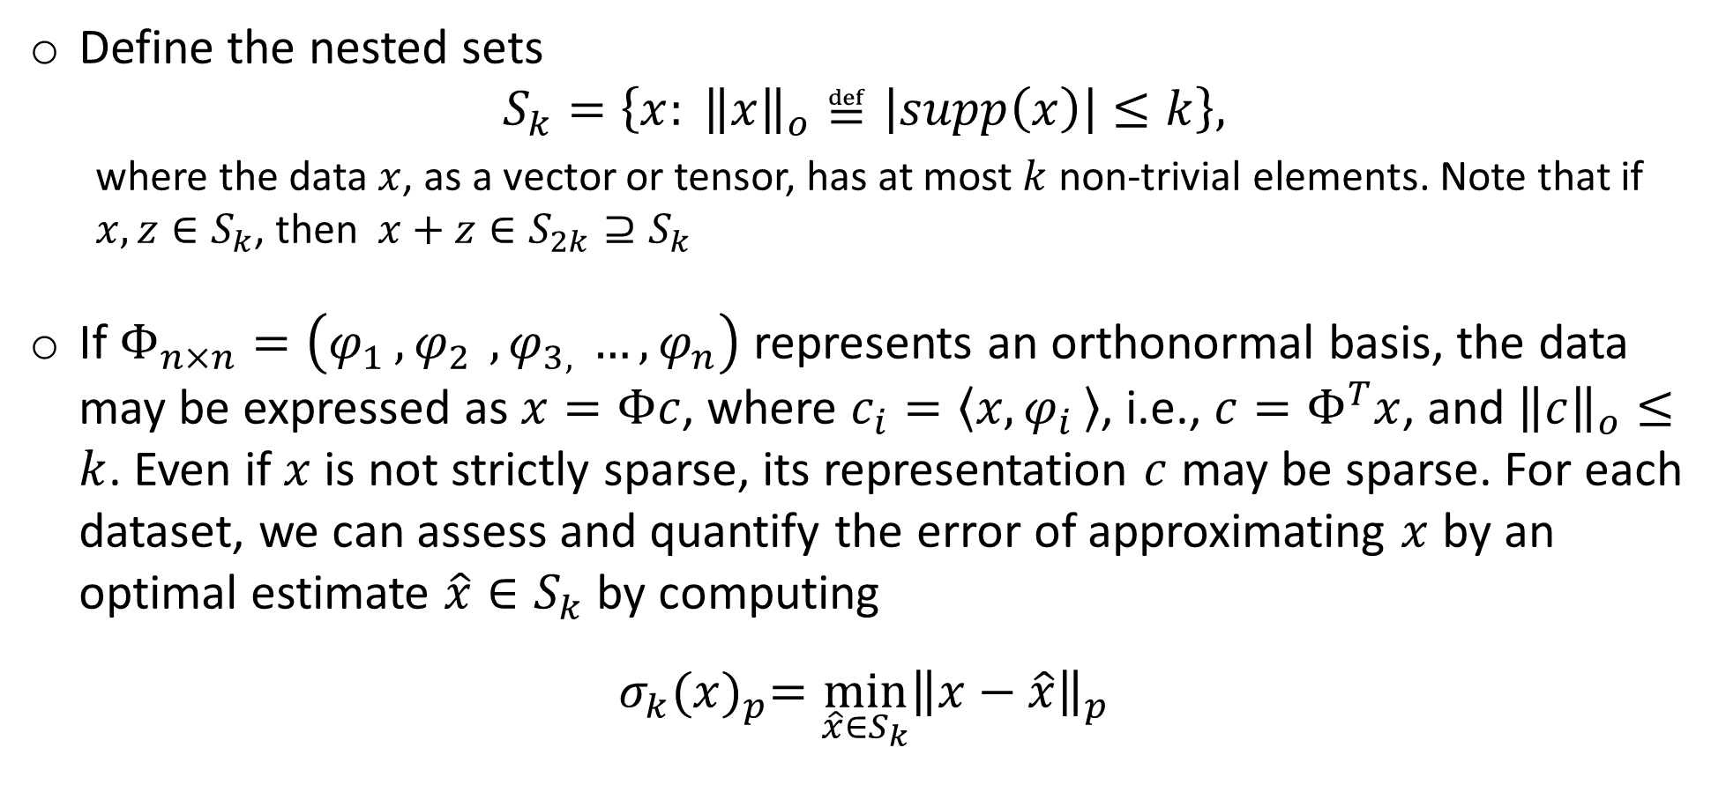
Big Data Analytics – Compressive Sensing
Define the nested sets
$$S_{k}=\left\{x: {\left\|x\right\|}_{o}≝\left|supp\left(x\right)\right|≤k\right\},$$
where the data $x$, as a vector or tensor, has at most $k$ non-trivial elements. Note that if $x,z∈S_{k}$, then $x+z∈S_{2k}⊇S_{k}$
If $Φ_{n×n}=\left(φ_{1 }{, φ}_{2 }, φ_{3, }…, φ_{n}\right)$ represents an orthonormal basis, the data may be expressed as $x=Φc$, where $c_{i}=〈x,φ_{i }〉$, i.e., $c=Φ^{T}x$, and ${\left\|c\right\|}_{o}≤k$. Even if $x$ is not strictly sparse, its representation $c$ may be sparse. For each dataset, we can assess and quantify the error of approximating $x$ by an optimal estimate $\hat{x}{∈S}_{k}$ by computing
$$σ_{k}{(x)}_{p}=\min_{\hat{x}{∈S}_{k}}{{\left\|x−\hat{x}\right\|}_{p}}$$

Slide 14

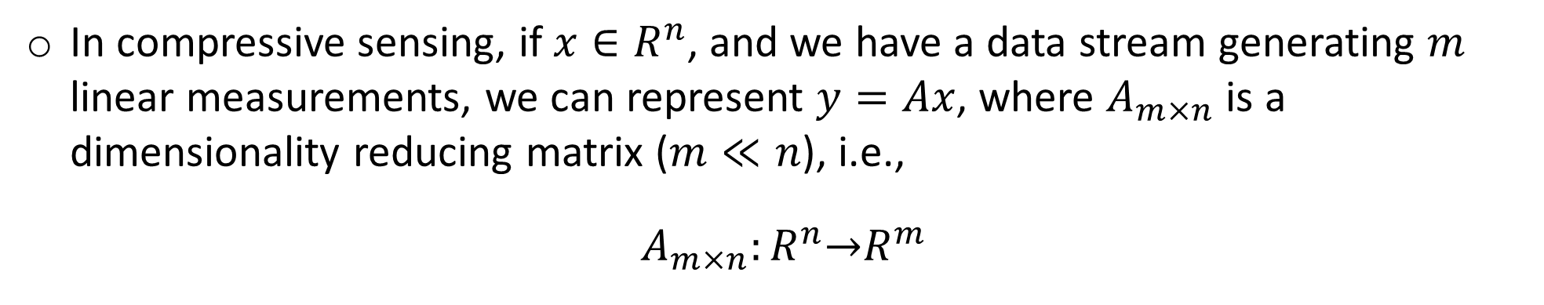
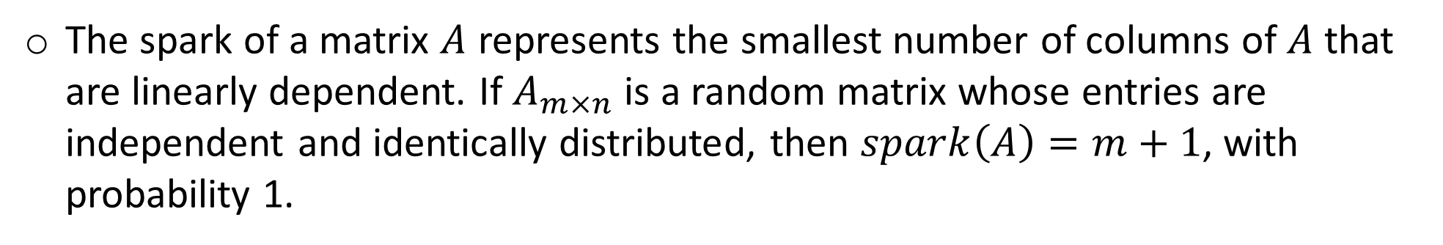
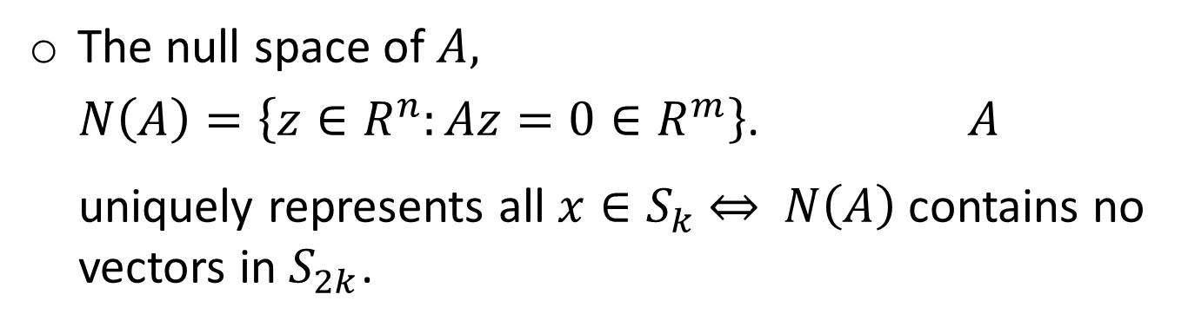
Big Data Analytics – Compressive Sensing
In compressive sensing, if $x∈R^{n}$, and we have a data stream generating $m$ linear measurements, we can represent $y=Ax$, where $A_{m×n}$ is a dimensionality reducing matrix ($m≪n$), i.e.,
$A_{m×n}:R^{n}\underset{→}{}R^{m}$
The null space of $A,$
$N\left(A\right)=\left\{z∈R^{n}:Az=0∈R^{m}\right\}$. $A$ uniquely represents all $x∈S_{k} \underset{⇔}{}$ $N\left(A\right)$ contains no vectors in $S_{2k}$.
The spark of a matrix $A$ represents the smallest number of columns of $A$ that are linearly dependent. If $A_{m×n}$ is a random matrix whose entries are independent and identically distributed, then $spark\left(A\right)=m+1$, with probability 1.

Slide 15
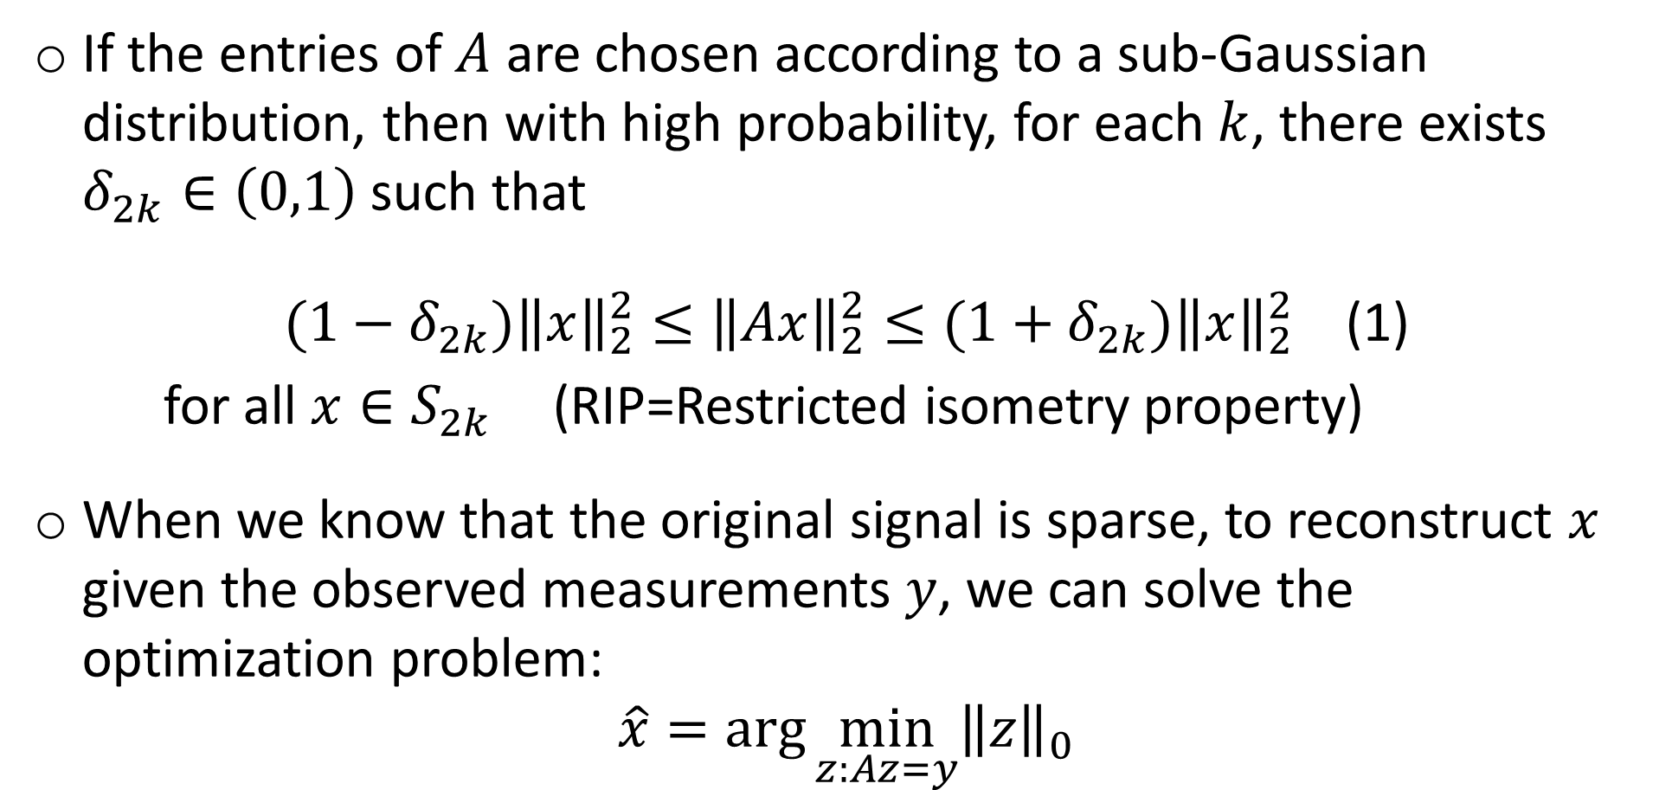
Big Data Analytics – Compressive Sensing
If the entries of $A$ are chosen according to a sub-Gaussian distribution, then with high probability, for each $k$, there exists $δ_{2k}∈\left(0,1\right)$ such that
$(1−δ_{2k}){\left\|x\right\|}_{2}^{2}≤{\left\|Ax\right\|}_{2}^{2}≤(1+δ_{2k}){\left\|x\right\|}_{2}^{2}$ (1)
for all $x∈S_{2k}$ (RIP=Restricted isometry property)
When we know that the original signal is sparse, to reconstruct $x$ given the observed measurements $y$, we can solve the optimization problem:
$$\hat{x}=\arg{\min_{z:Az=y}{{\left\|z\right\|}_{0}}}$$
Notes:
Restricted Isometry Property (RIP)

Slide 16
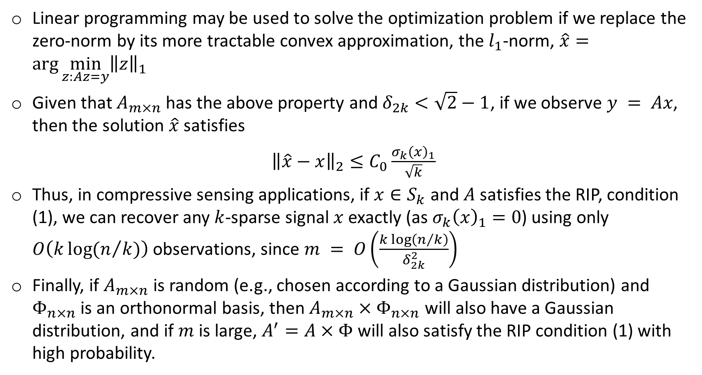
Big Data Analytics – Compressive Sensing
Linear programming may be used to solve the optimization problem if we replace the zero-norm by its more tractable convex approximation, the $l_{1}$-norm, $\hat{x}=\arg{\min_{z:Az=y}{{\left\|z\right\|}_{1}}}$
Given that $A_{m×n}$ has the above property and $δ_{2k}<\sqrt{2}−1$, if we observe $y = Ax$, then the solution $\hat{x}$ satisfies
${\left\|\hat{x}−x\right\|}_{2}≤C_{0}\frac{σ_{k}{\left(x\right)}_{1}}{\sqrt{k}}$
Thus, in compressive sensing applications, if $x∈S_{k}$ and $A$satisfies the RIP, condition (1), we can recover any $k$-sparse signal $x$ exactly (as $σ_{k}{\left(x\right)}_{1}=0$) using only $O\left(k\log{(n/k)}\right)$ observations, since $m = O\left(\frac{k\log\left(n/k\right)}{δ_{2k}^{2}}\right)$
Finally, if $A_{m×n}$ is random (e.g., chosen according to a Gaussian distribution) and $Φ_{n×n}$ is an orthonormal basis, then $A_{m×n}×Φ_{n×n}$ will also have a Gaussian distribution, and if $m$ is large, $A^{′}=A×Φ$ will also satisfy the RIP condition (1) with high probability.

Slide 17
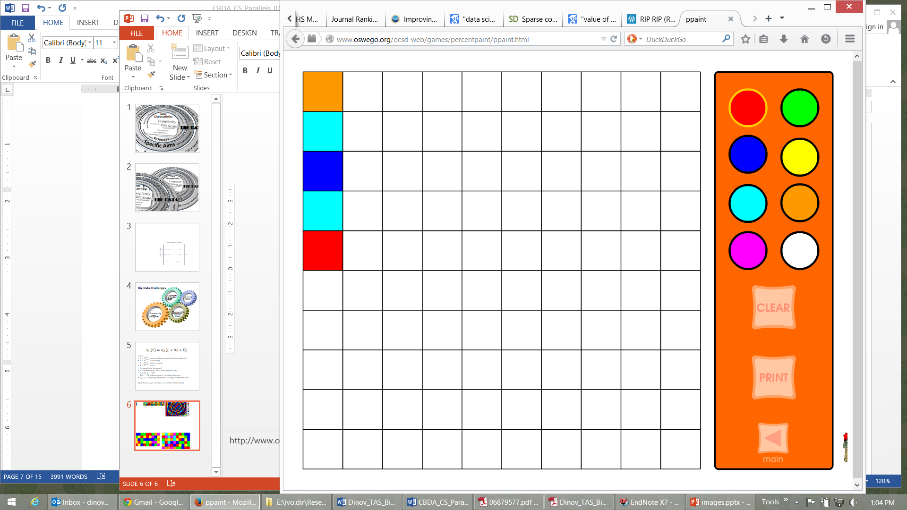
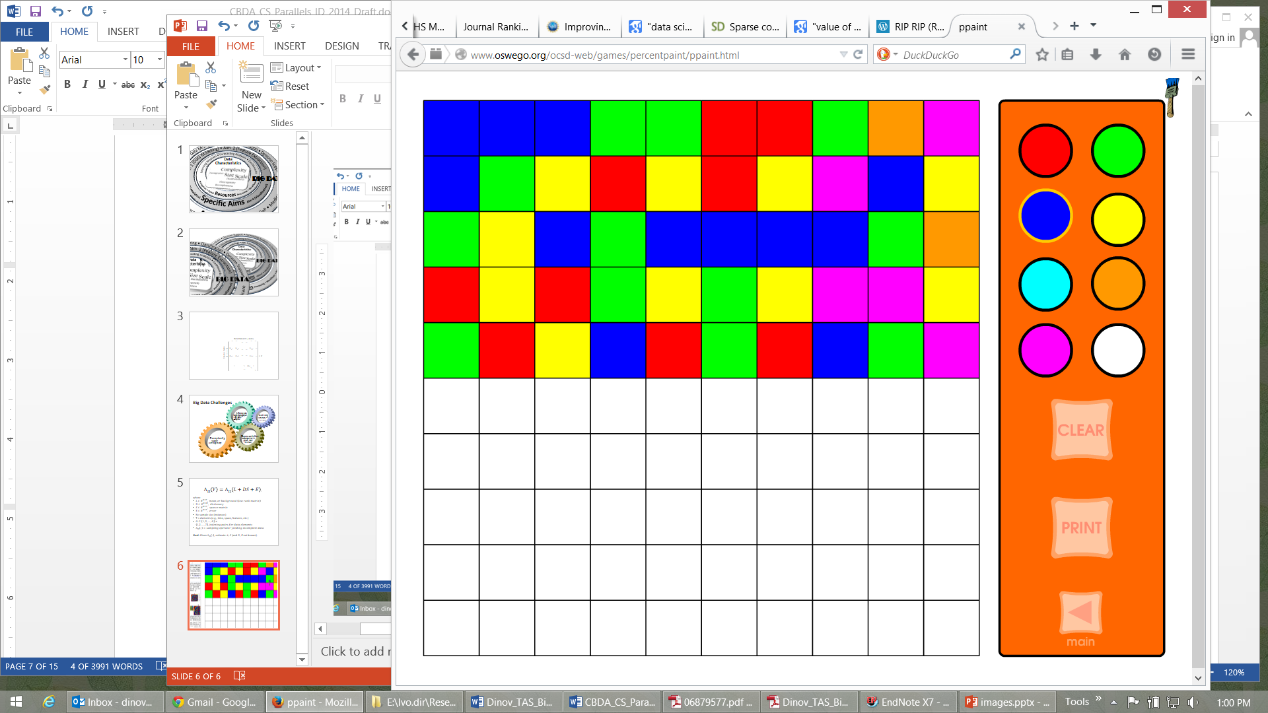
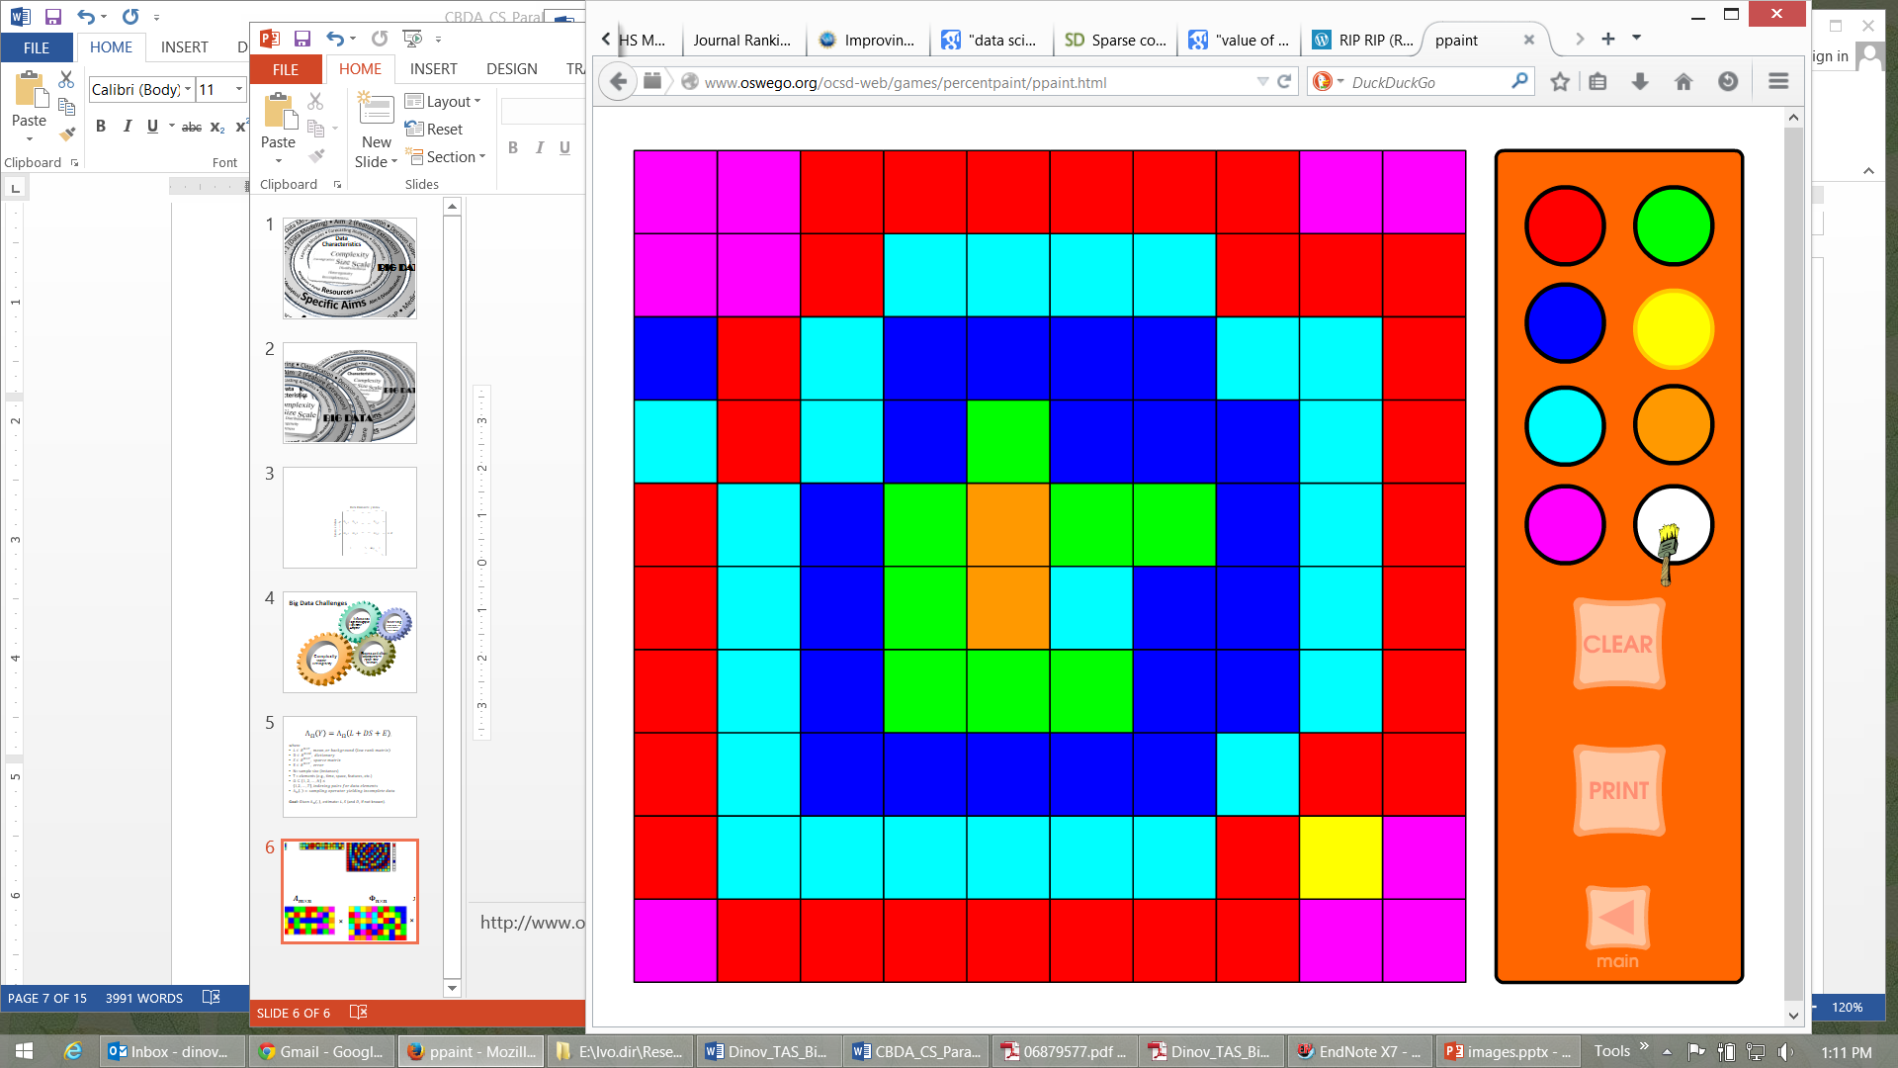
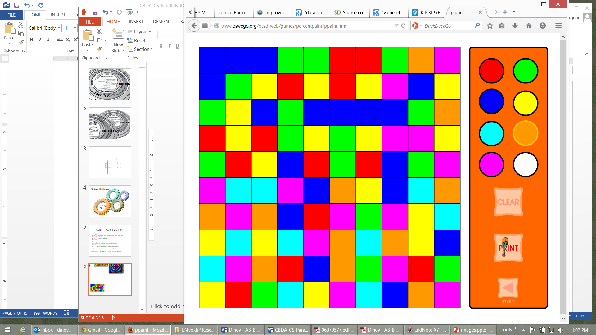
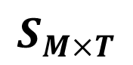
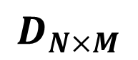
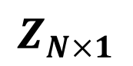
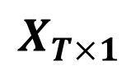
Big Data Analytics – Compressive Sensing
$$Z_{N×1}$$
$$D_{N×M}$$
$$S_{M×T}$$
$$X_{T×1}$$
=
×
×
Obs Proxy Prism (dim reducing matrix) Orthonormal basis Nat Process

Slide 18
Compressive Big Data Analytics (CBDA)
The foundation for Compressive Big Data Analytics (CBDA) involves
Iteratively generating random (sub)samples from the Big Data collection.
Then, using classical techniques to obtain model-based or non-parametric inference based on the sample.
Next, compute likelihood estimates (e.g., probability values quantifying effects, relations, sizes)
Repeat – the process continues iteratively.
Repeating the (re)sampling and inference steps many times (with or without using the results of previous iterations as priors for subsequent steps).
Dinov, J Med Stat & Info, 2016

Slide 19
Compressive Big Data Analytics (CBDA)
Bootstrapping techniques may be employed to quantify joint probabilities, estimate likelihoods, predict associations, identify trends, forecast future outcomes, or assess accuracy of findings.
The goals of compressive sensing and compressive big data analytics are different.
CS aims to obtain a stochastic estimate of a complete dataset using sparsely sampled incomplete observations.
CBDA attempts to obtain a quantitative joint inference characterizing likelihoods, tendencies, prognoses, or relationships.
However, a common objective of both problem formulations is the optimality (e.g., reliability, consistency) of their corresponding estimates.

Slide 20
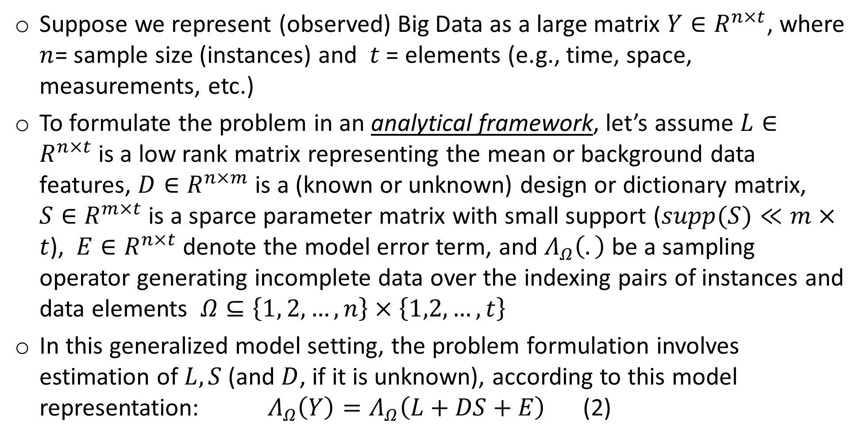
Compressive Big Data Analytics (CBDA)
Suppose we represent (observed) Big Data as a large matrix ${Y∈R}^{n×t}$, where $n$= sample size (instances) and $t$ = elements (e.g., time, space, measurements, etc.)
To formulate the problem in an analytical framework, let’s assume $L∈R^{n×t}$is a low rank matrix representing the mean or background data features, $D∈R^{n×m}$ is a (known or unknown) design or dictionary matrix, $S∈R^{m×t}$ is a sparce parameter matrix with small support ($supp(S)≪m×t$), $E∈R^{n×t}$ denote the model error term, and $Λ_{Ω}\left(.\right)$ be a sampling operator generating incomplete data over the indexing pairs of instances and data elements $Ω⊆\left\{1, 2, …, n\right\}×\left\{1,2,…,t\right\}$
In this generalized model setting, the problem formulation involves estimation of $L, S$(and $D$, if it is unknown), according to this model representation:$Λ_{Ω}\left(Y\right)=Λ_{Ω}\left(L+DS+E\right)$ (2)

Slide 21
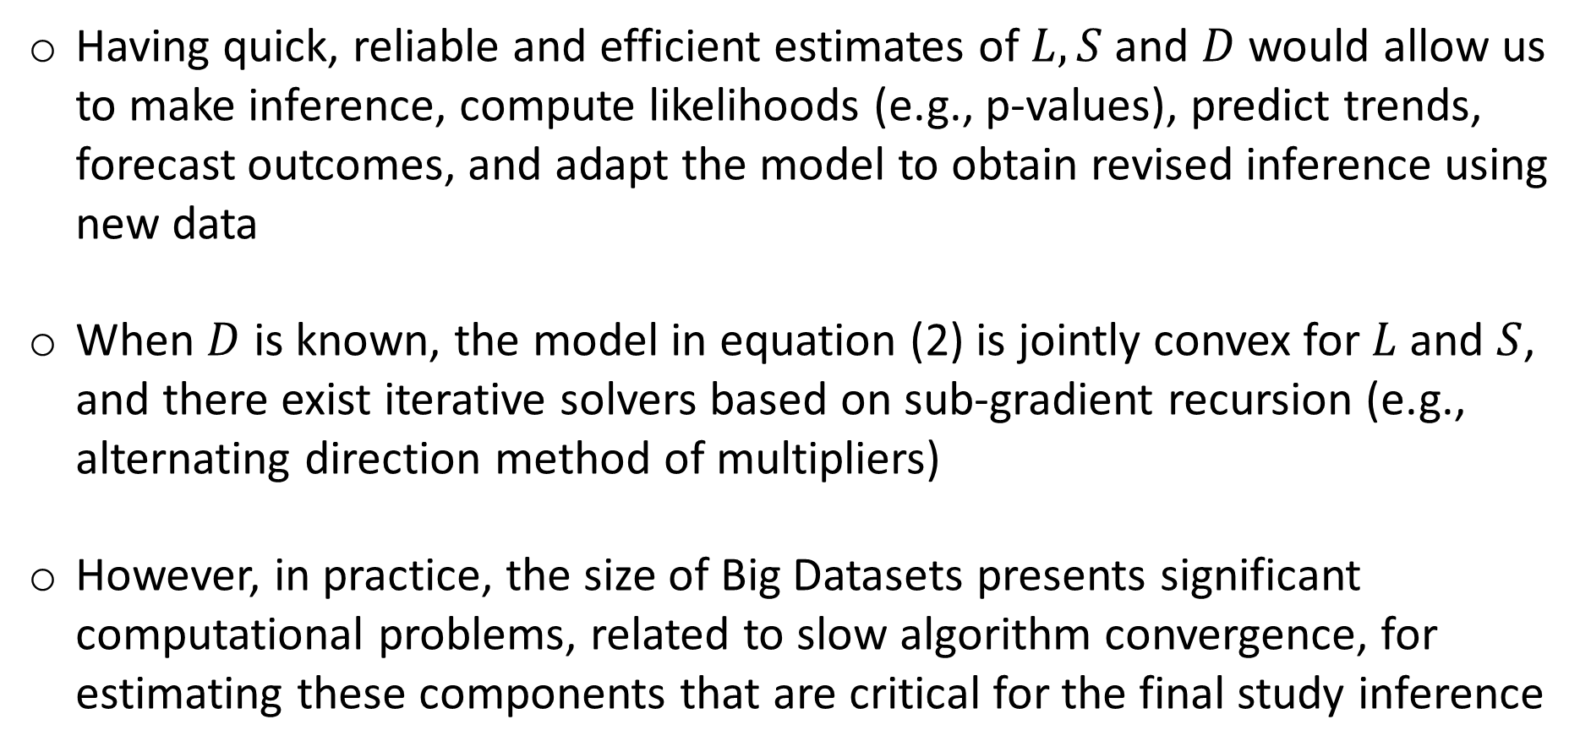
Compressive Big Data Analytics (CBDA)
Having quick, reliable and efficient estimates of $L, S$and $D$ would allow us to make inference, compute likelihoods (e.g., p-values), predict trends, forecast outcomes, and adapt the model to obtain revised inference using new data
When $D$ is known, the model in equation (2) is jointly convex for $L$ and $S$, and there exist iterative solvers based on sub-gradient recursion (e.g., alternating direction method of multipliers)
However, in practice, the size of Big Datasets presents significant computational problems, related to slow algorithm convergence, for estimating these components that are critical for the final study inference

Slide 22
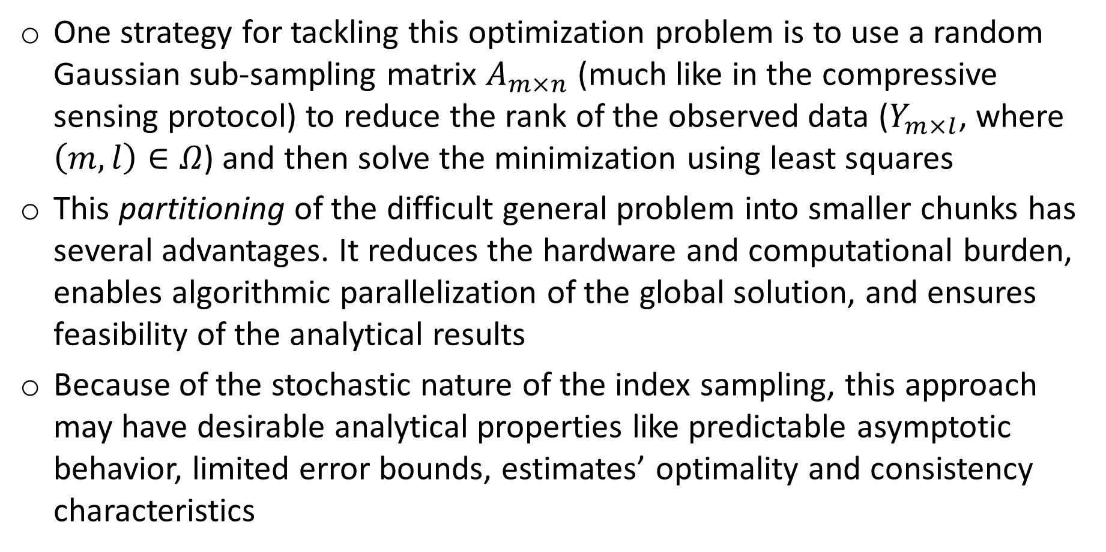
Compressive Big Data Analytics (CBDA)
One strategy for tackling this optimization problem is to use a random Gaussian sub-sampling matrix $A_{m×n}$ (much like in the compressive sensing protocol) to reduce the rank of the observed data ($Y_{m×l}$, where $\left(m,l\right)∈Ω$) and then solve the minimization using least squares
This partitioning of the difficult general problem into smaller chunks has several advantages. It reduces the hardware and computational burden, enables algorithmic parallelization of the global solution, and ensures feasibility of the analytical results
Because of the stochastic nature of the index sampling, this approach may have desirable analytical properties like predictable asymptotic behavior, limited error bounds, estimates’ optimality and consistency characteristics

Slide 23


Compressive Big Data Analytics (CBDA)
Data Structure (Representation) Sample Data (Instance)

Slide 24
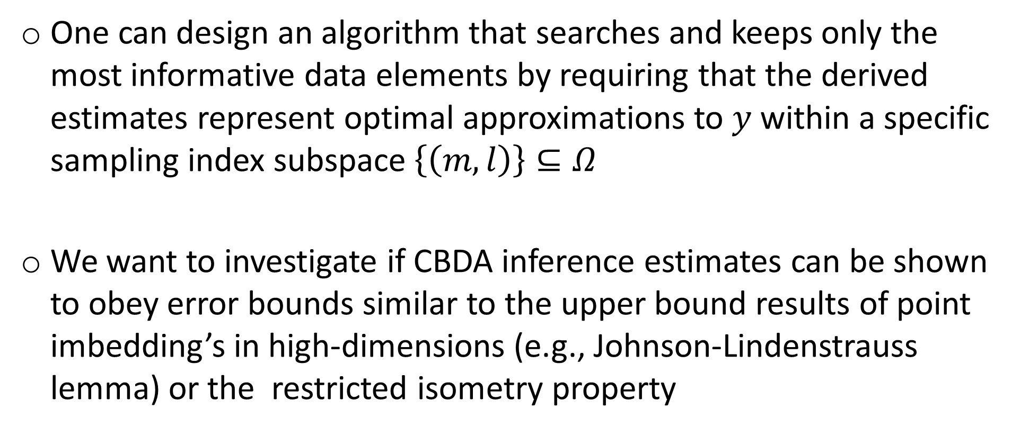
Compressive Big Data Analytics (CBDA)
One can design an algorithm that searches and keeps only the most informative data elements by requiring that the derived estimates represent optimal approximations to $y$within a specific sampling index subspace $\left\{\left(m,l\right)\right\}⊆Ω$
We want to investigate if CBDA inference estimates can be shown to obey error bounds similar to the upper bound results of point imbedding’s in high-dimensions (e.g., Johnson-Lindenstrauss lemma) or the restricted isometry property

Slide 25
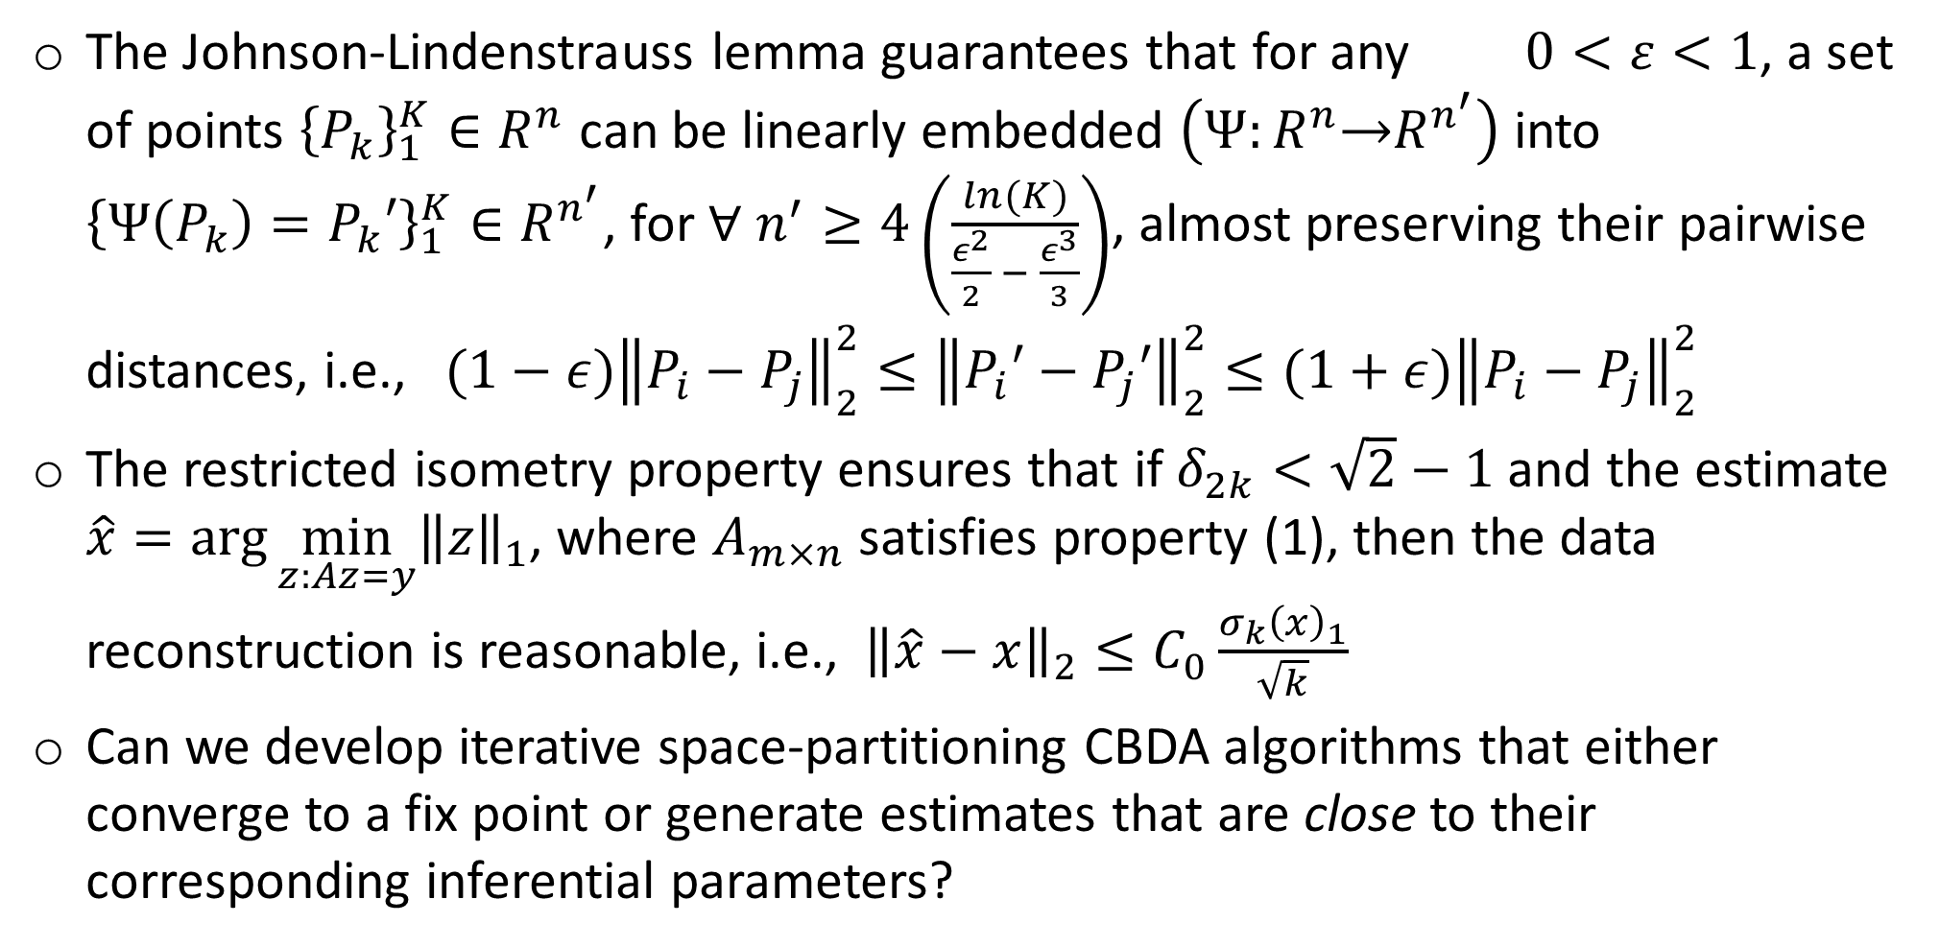
Compressive Big Data Analytics (CBDA)
The Johnson-Lindenstrauss lemma guarantees that for any $0<ε<1$, a set of points ${\left\{P_{k}\right\}}_{1}^{K}∈R^{n}$ can be linearly embedded $\left(Ψ:R^{n}\underset{→}{ }R^{n^{′}}\right)$ into ${{\left\{{Ψ\left(P_{k}\right)=P}_{k}′\right\}}_{1}^{K}∈R}^{n^{′}}$, for $∀$ $n^{′}≥4\left(\frac{ln⁡(K)}{\frac{ε^{2}}{2} − \frac{ε^{3}}{3}}\right)$, almost preserving their pairwise distances, i.e., $(1−ε){\left\|P_{i}−P_{j}\right\|}_{2}^{2}≤{\left\|P_{i}′−P_{j}′\right\|}_{2}^{2}{≤(1+ε)\left\|P_{i}−P_{j}\right\|}_{2}^{2}$
The restricted isometry property ensures that if $δ_{2k}<\sqrt{2}−1$ and the estimate $\hat{x}=\arg{\min_{z:Az=y}{{\left\|z\right\|}_{1}}}$, where $A_{m×n}$ satisfies property (1), then the data reconstruction is reasonable, i.e., ${\left\|\hat{x}−x\right\|}_{2}≤C_{0}\frac{σ_{k}{\left(x\right)}_{1}}{\sqrt{k}}$
Can we develop iterative space-partitioning CBDA algorithms that either converge to a fix point or generate estimates that are close to their corresponding inferential parameters?

Slide 26

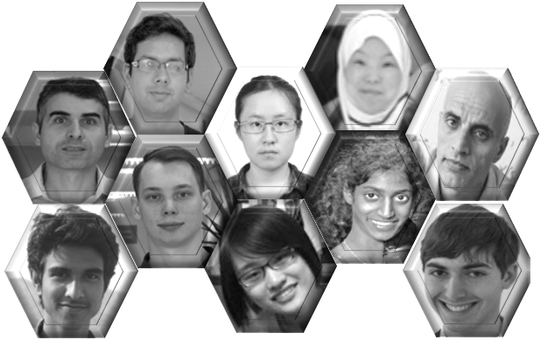



Acknowledgments
http://SOCR.umich.edu
Funding
NIH: P50 NS091856, P30 DK089503, P30AG053760, P20 NR015331, U54 EB020406
NSF: 1636840, 1416953, 0716055, 1023115
Collaborators
SOCR: Alexandr Kalinin, Selvam Palanimalai, Syed Husain, Matt Leventhal, Ashwini Khare, Rami Elkest, Abhishek Chowdhury, Patrick Tan, Gary Chan, Andy Foglia, Pratyush Pati, Brian Zhang, Juana Sanchez, Dennis Pearl, Kyle Siegrist, Rob Gould, Jingshu Xu, Nellie Ponarul, Ming Tang, Asiyah Lin, Nicolas Christou
LONI/INI: Arthur Toga, Roger Woods, Jack Van Horn, Zhuowen Tu, Yonggang Shi, David Shattuck, Elizabeth Sowell, Katherine Narr, Anand Joshi, Shantanu Joshi, Paul Thompson, Luminita Vese, Stan Osher, Stefano Soatto, Seok Moon, Junning Li, Young Sung, Fabio Macciardi, Federica Torri, Carl Kesselman,
UMich AD/PD Centers: Cathie Spino, Brian, Athey, Hank Paulson, Ben Hampstead, Bill Dauer

